Slide 1


Slide 2

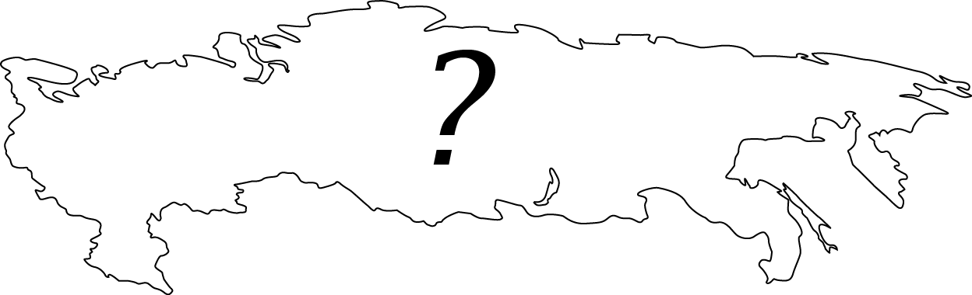
RUSSIAN ENERGY DILEMMA
Will Europe use Russian resources in the future?
Will China become a larger importer of Russian oil and gas?
Will Russia have more investitions for energy products?
Where will Russian oil be needed?
What can Russia recieve from exporting gas?
Will there be more concurents on the market?

Slide 3
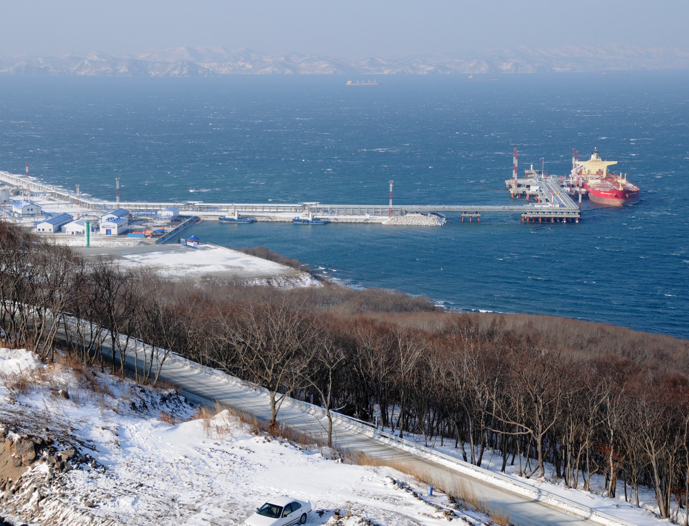
Oil Export Strategy for Russia

Slide 4
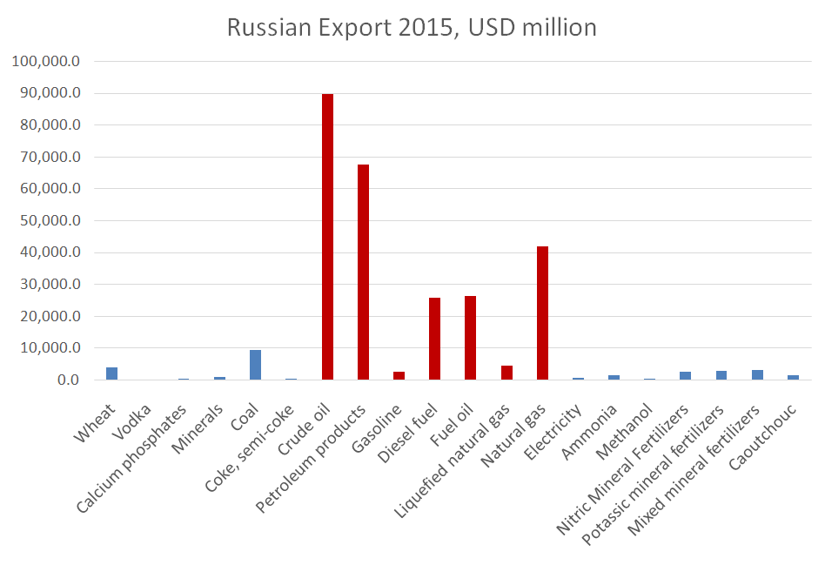
WHY OIL IS IMPORTANT?

Slide 5
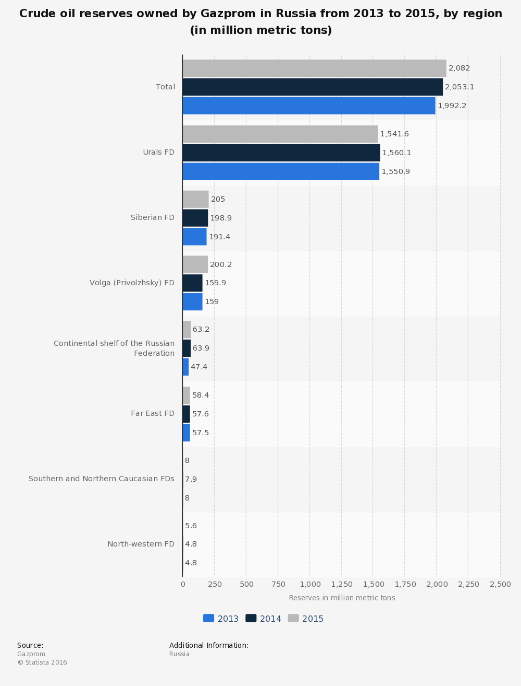
OIL RESERVES
DOMESTIC
WORLDWIDE

Slide 6
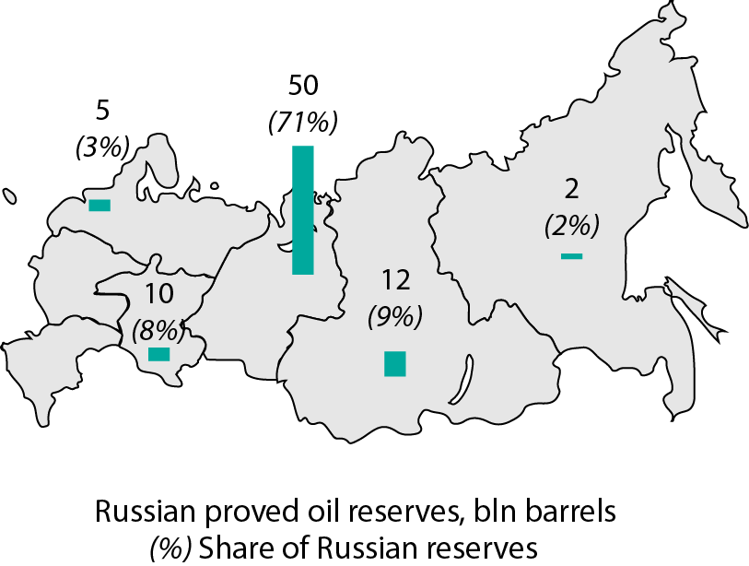
OIL RESERVES
Where are the largest Russian oil reserves located?
Western Siberia will remain the most important Russian oil producing region for decades.

Slide 7
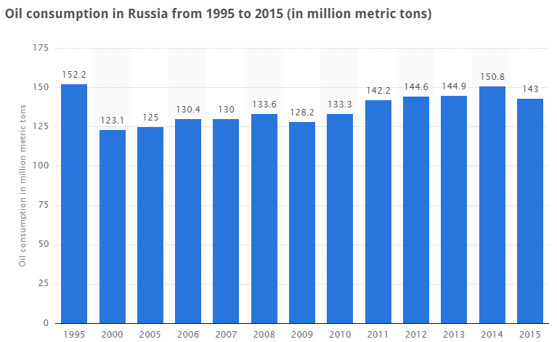
OIL DEMAND

Slide 8
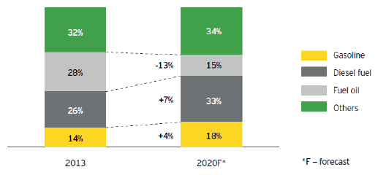
OIL DEMAND
Product mix of domestic Russian refineries after upgrading (EY)

Slide 9
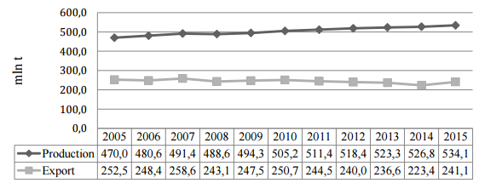
OIL PRODUCTION & EXPORTS
One of the world’s largest oil producer
Balance government budget

Slide 10
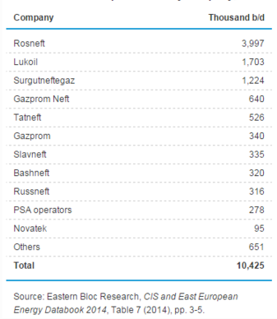
OIL PRODUCTION
Russia's oil production by company (2013)

Slide 11
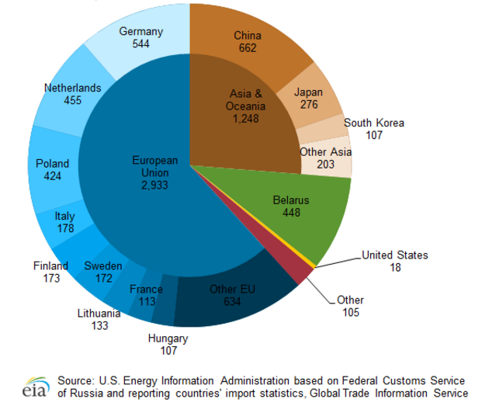
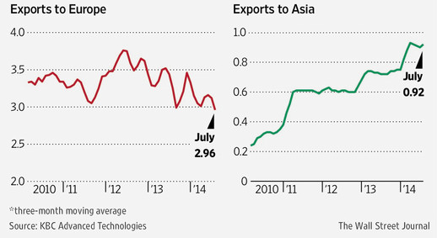
OIL EXPORT TREND
A shift of oil markets ------ from West to East
(Exports via transneft pipeline, in millions of barrels a day)
oil exports by destinations (2014)
Around 30% oil exports of 2014 have gone to Asia. (and are expected to rise)
As stated in its Energy Strategy, Russia intends to double the flow of oil to Asia by 2035.
tax breaks/ fiscal incentives

Slide 12
Have western sanctions affected the Russian oil sector?
How?

Slide 13
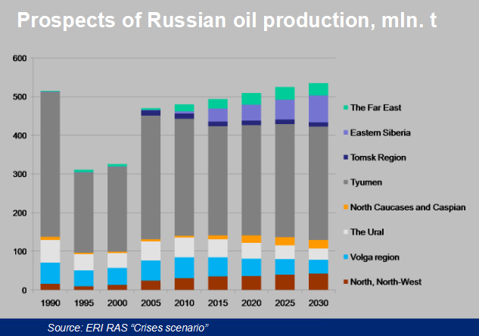
OIL RESERVES & PROSPECTIVES

Slide 14
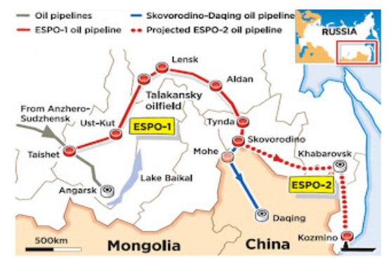
additional flexibility
MAJOR OIL EXPORT PROJECTS
On Eastern market
ESPO-2 (2012)
“ loan-for-oil ”

Slide 15
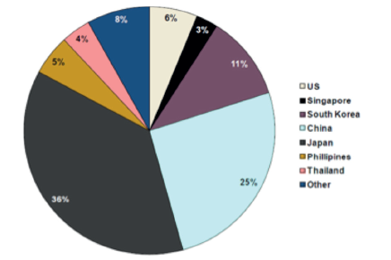
ESPO buyers by share in 2013
OIL BUYERS

Slide 16
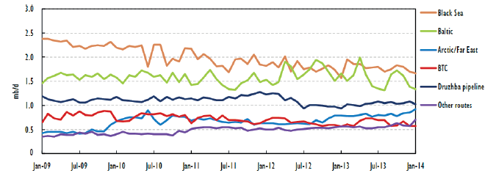
OIL DEMAND
In Western market
Russian crude exports by major export direction
(source: IEA)

Slide 17
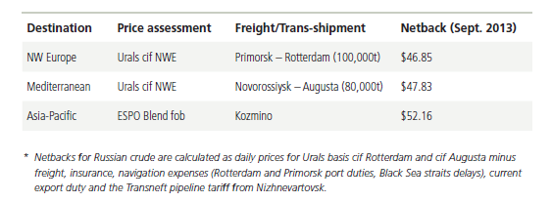
Russian netbacks of crude oil (source: PIW)

Slide 18
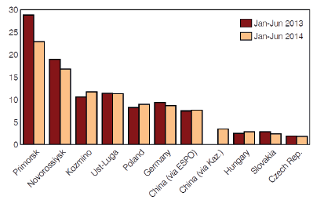
OIL EXPORTS
Russian crude oil exports by route in MT
(source: ARGUS NEFTE TRANTRANSPORT)

Slide 19
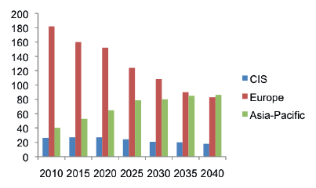
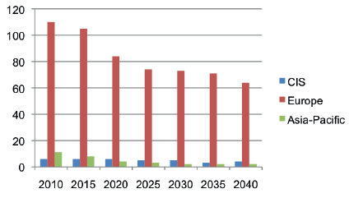
OIL EXPORT FORECAST
crude oil exports from Russia by detination, IN MT, 2010-2040
(baseline scenario, eri ras)
oil product exports from Russia by detination, IN MT, 2010-2040
(baseline scenario, eri ras)

Slide 20
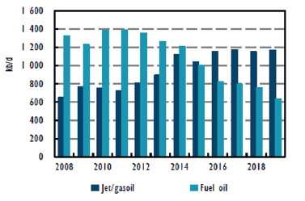
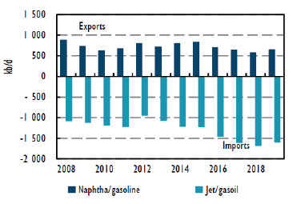
FSU key product exports
(IEA)
Europe's key product balances
(IEA)

Slide 21
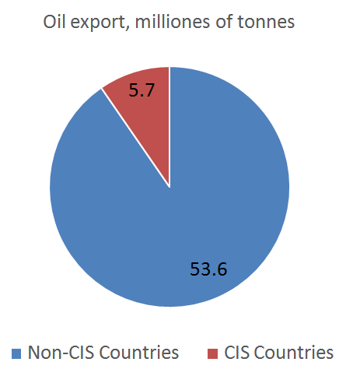
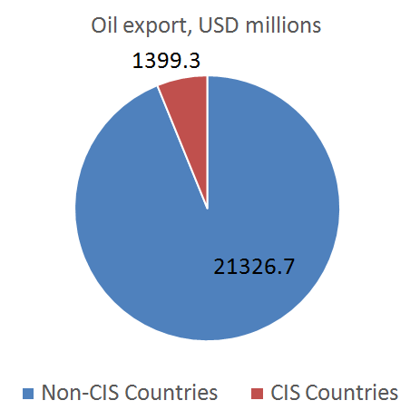
OIL EXPORT

Slide 22

Does Europe need more Russian oil?

Slide 23

NETHERLANDS

Slide 24

GERMANY

Slide 25

POLAND

Slide 26

ITALY

Slide 27
CONTRACTS
Concession
A grant of rights, land or property by a government, local authority, corporation, individual or other legal entity.
Production sharing
A common type of contract signed between a government and a resource extraction company (or group of companies) concerning how much of the resource (usually oil) extracted from the country each will receive.

Slide 28
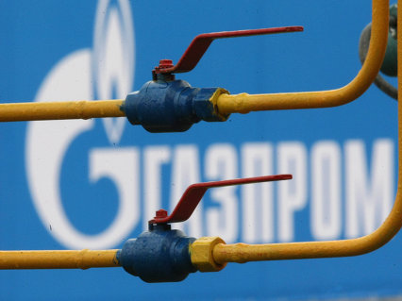
Gas Export Strategy for Russia

Slide 29
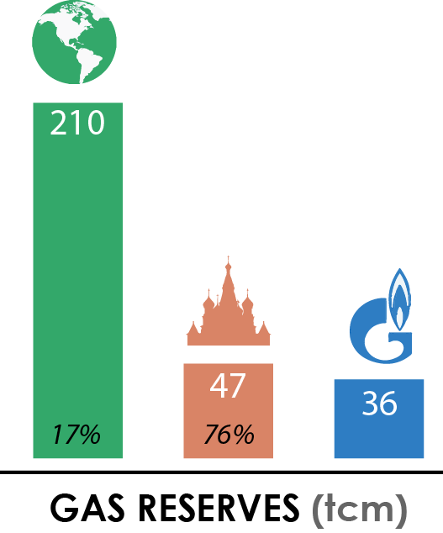
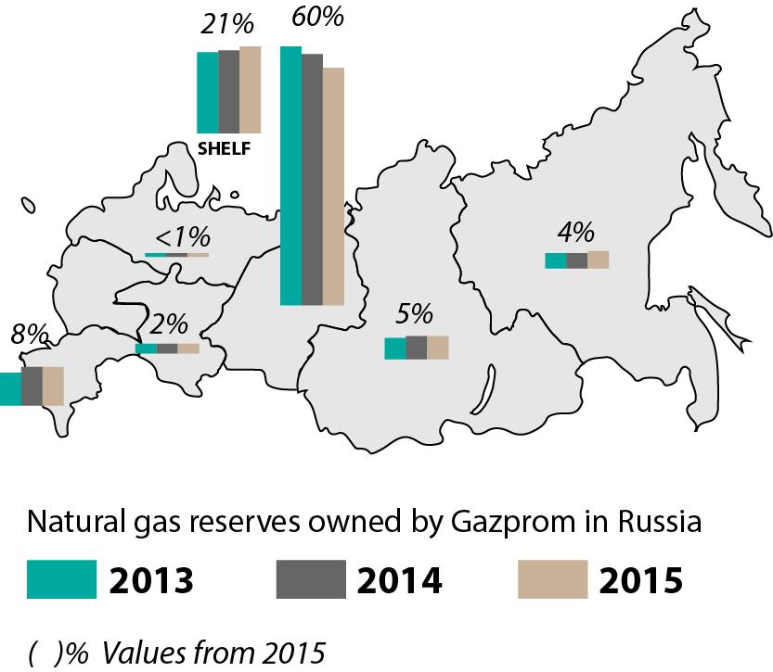
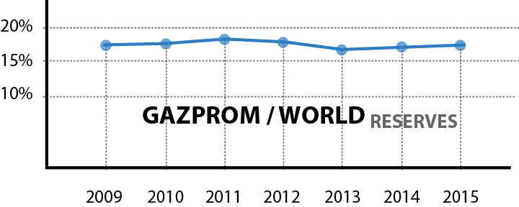
GAS RESERVES
17%
World’s largest gas reserves

Slide 30
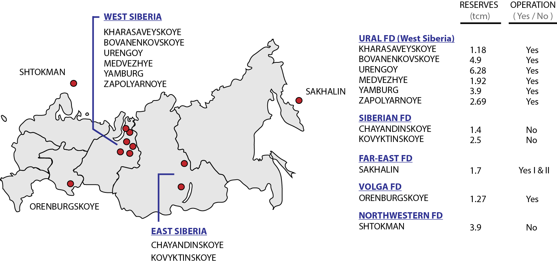
GAS RESERVES

Slide 31
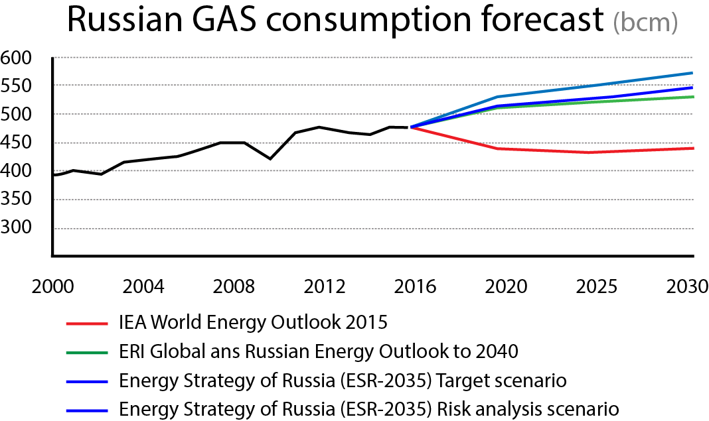
GAS DEMAND RUSSIA
Already half of the country’s total primary energy demand
Huge potential for efficiency savings in Russia’s gas-using infrastructure (especially power Generation)
Marginal growth in GDP

Slide 32
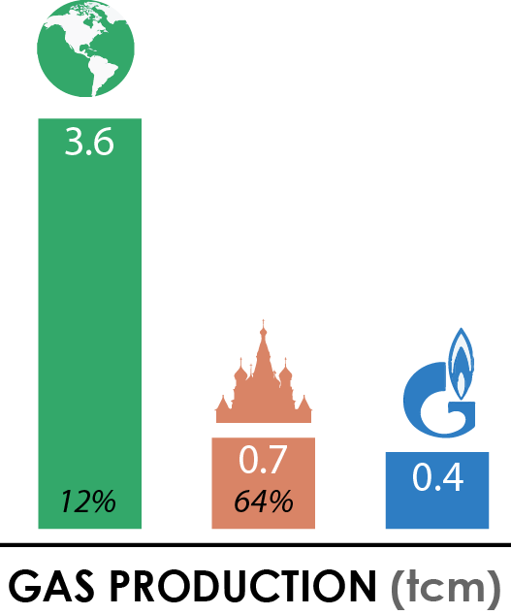
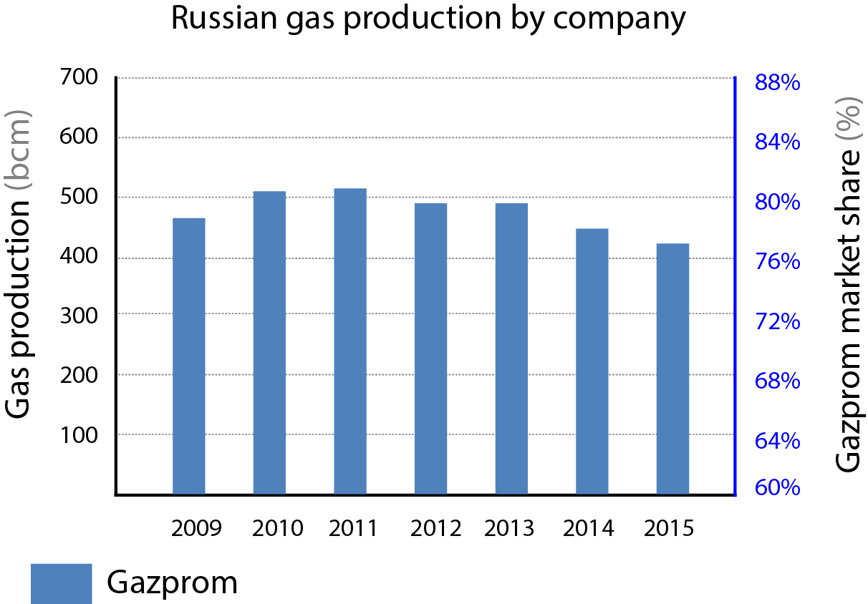
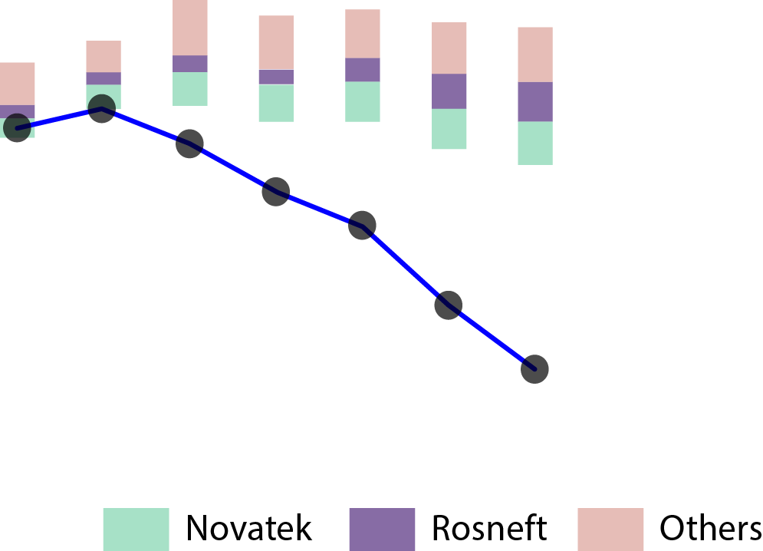
GAS PRODUCTION RUSSIA

Slide 33
GAS PRODUCTION RUSSIA
Owner of the pipeline system (UGSS). Although Third Party Access regulations, Gazprom monopolize the data of capacity utilization of the system
Influence in the annual Gas Balance in Russia (Where projected gas production levels are set for one year ahead)

Slide 34
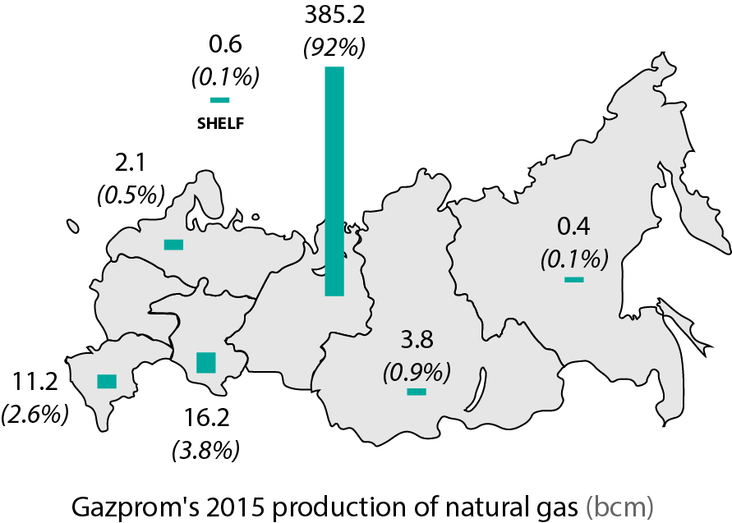

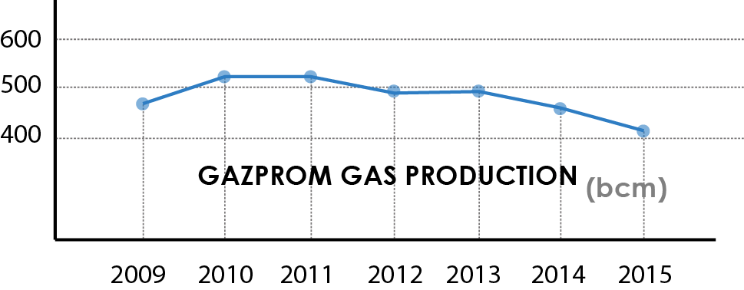
GAS PRODUCTION RUSSIA
2014
CAPACITY
FACTOR
“Today Gazprom’s production opportunities come up to 617 bcm of gas. The volume of gas produced by the Company in 2014 totaled 444 bcm”
72%
Alexey Miller
CEO Gazprom
OVERSUPPLY

Slide 35
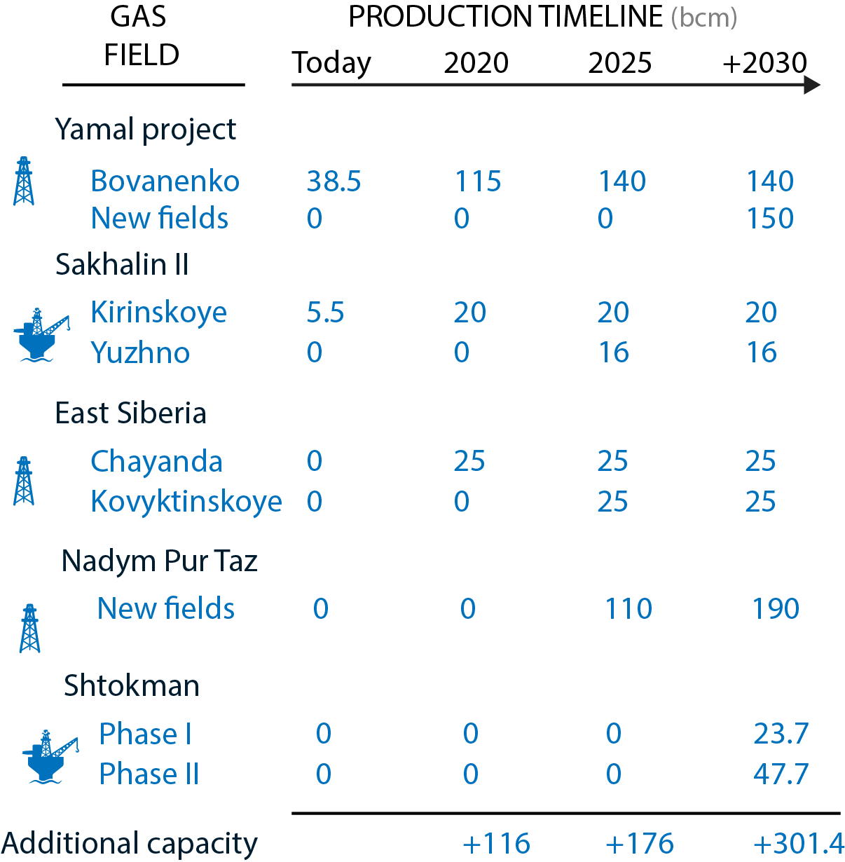
GAZPROM ADDITIONAL CAPACITY

Slide 36
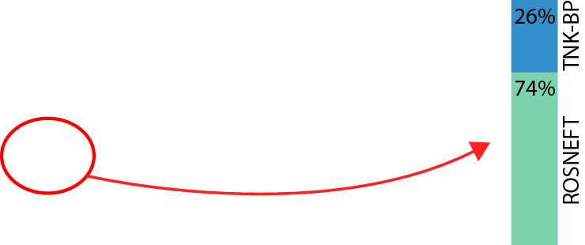
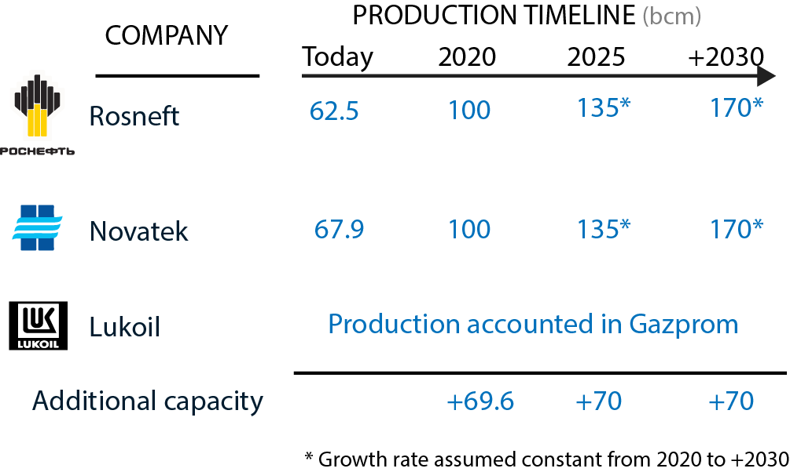
NGP ADDITIONAL CAPACITY

Slide 37
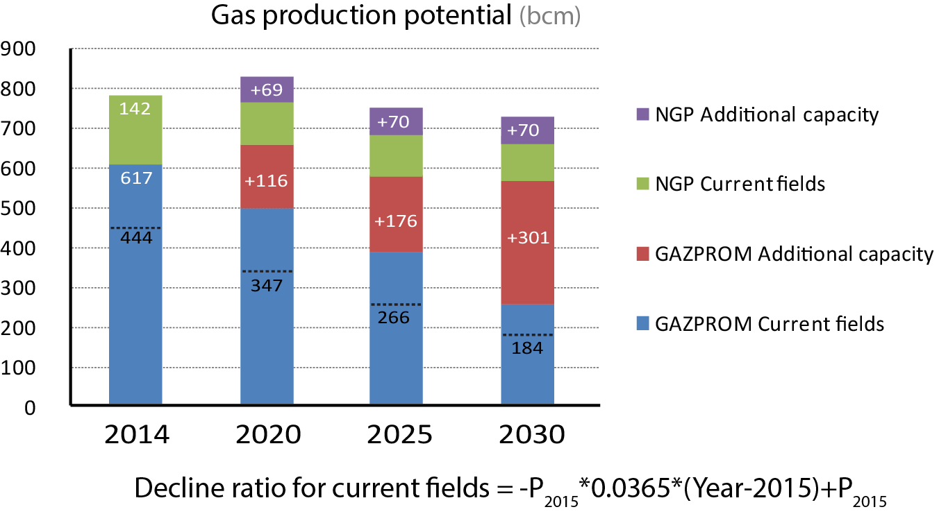
RUSSIA’s PRODUCTION FORECAST
GAZPROM CAPACITY 100%

Slide 38
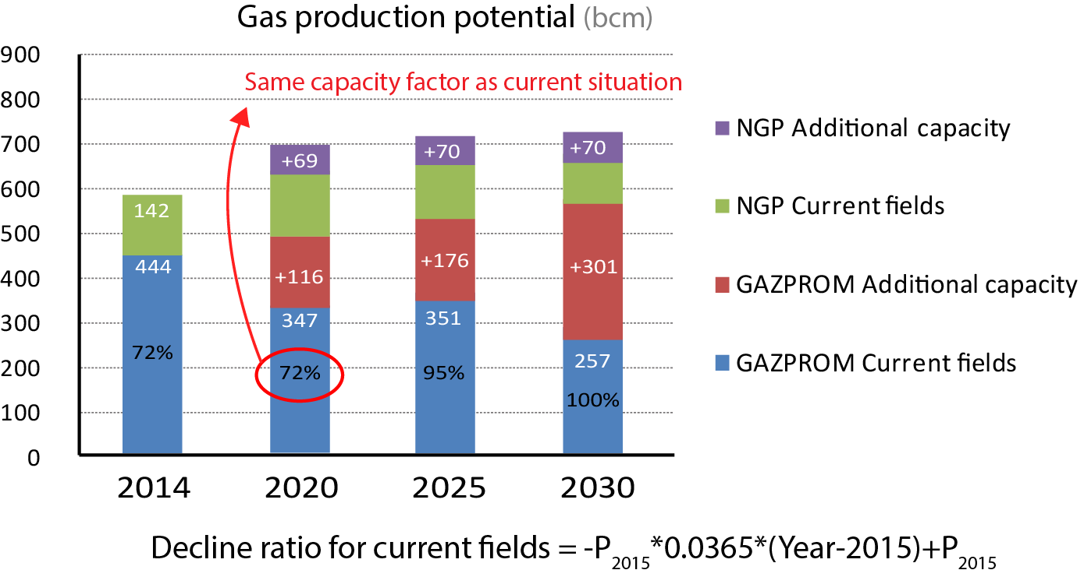
RUSSIA’s PRODUCTION FORECAST

Slide 39
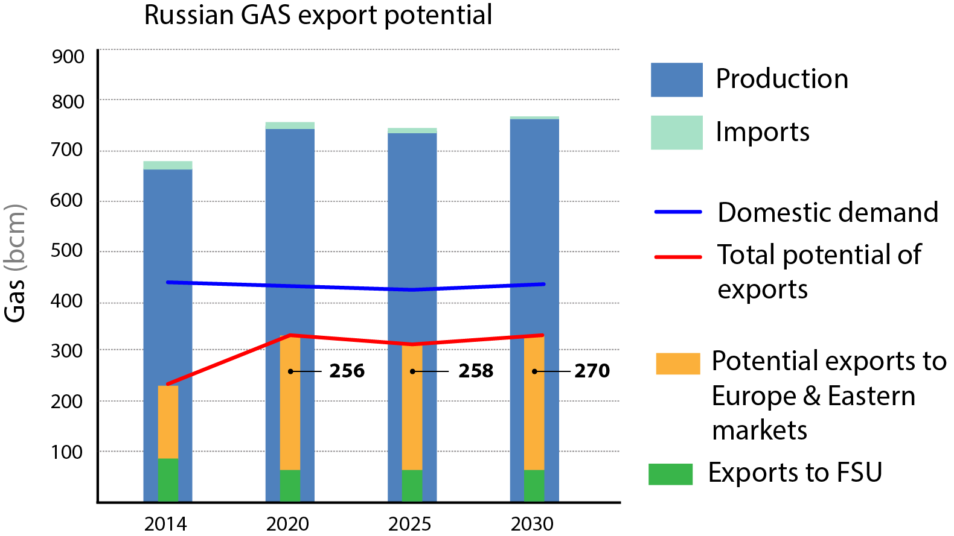
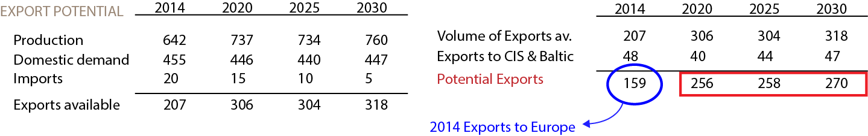
RUSSIA’s EXPORT POTENTIAL

Slide 40
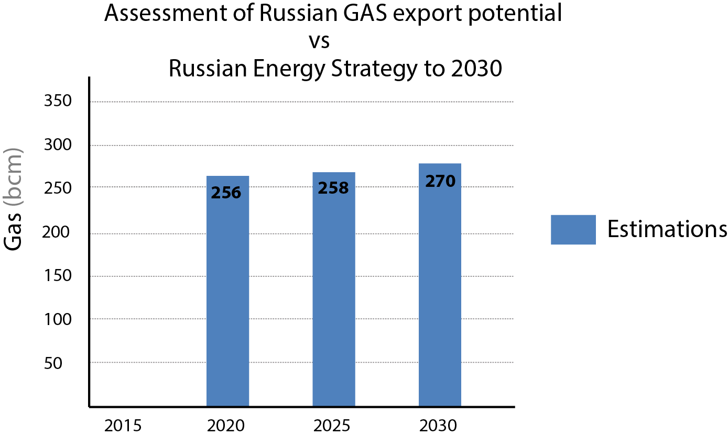
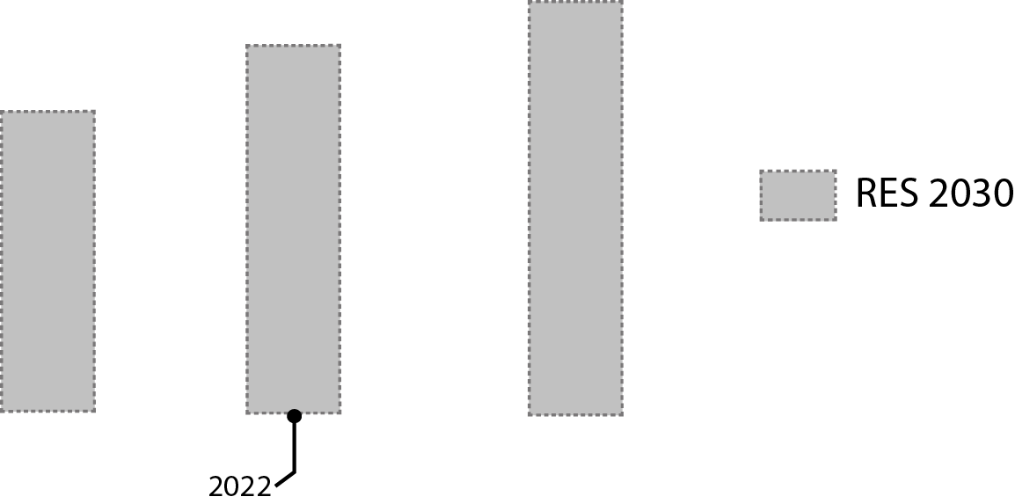
RUSSIA’s PRODUCTION FORECAST

Slide 41
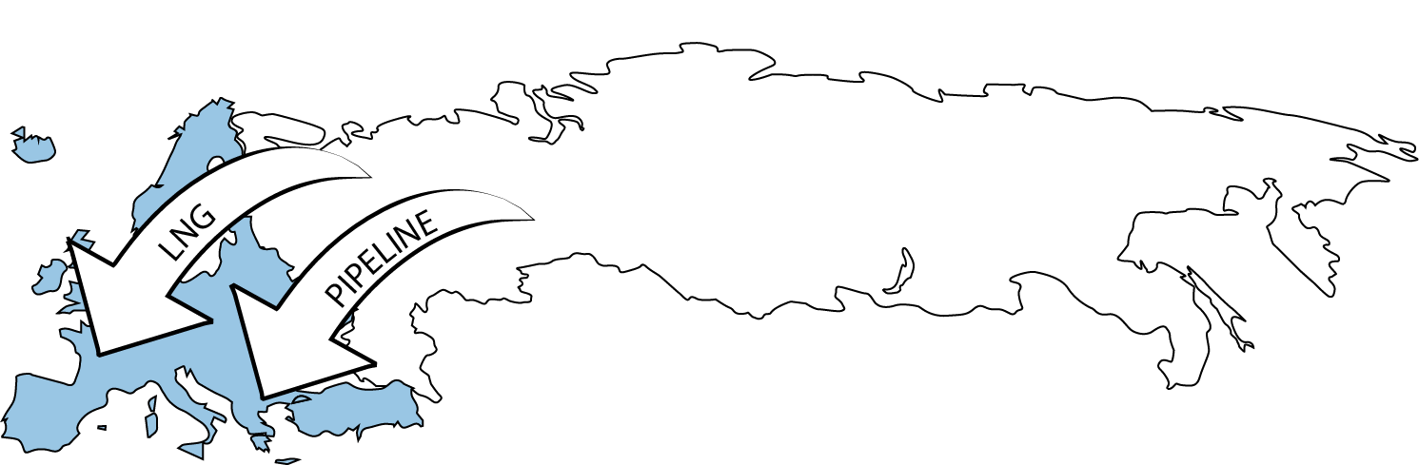
WESTERN GAS MARKETS

Slide 42
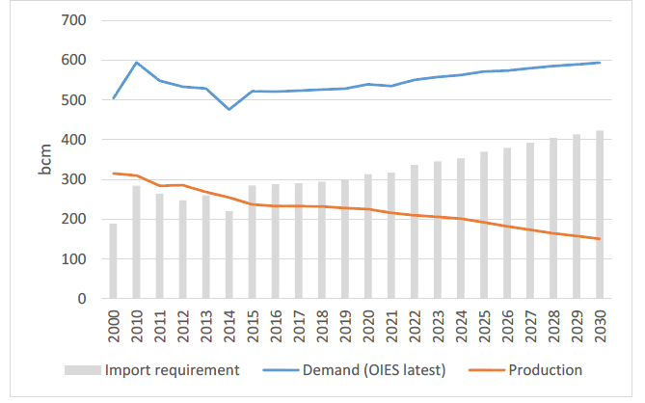
EUROPEAN GAS MARKET
Gazproms current market in the EU

Slide 43
EUROPEAN GAS MARKET
Russia’s conflict with Ukraine
Russian gas monopoly in the EU

Slide 44
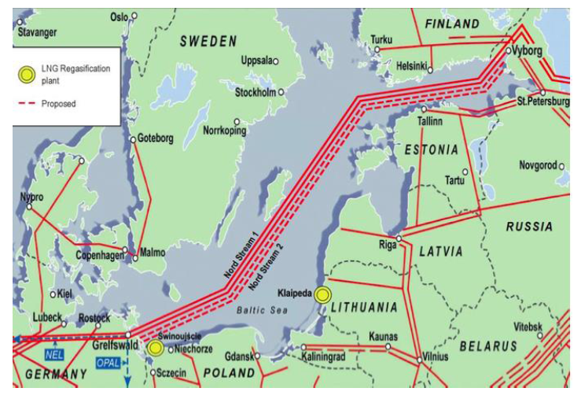
EUROPEAN GAS MARKET
Russia still managing its hold over the European market
The NORD II

Slide 45
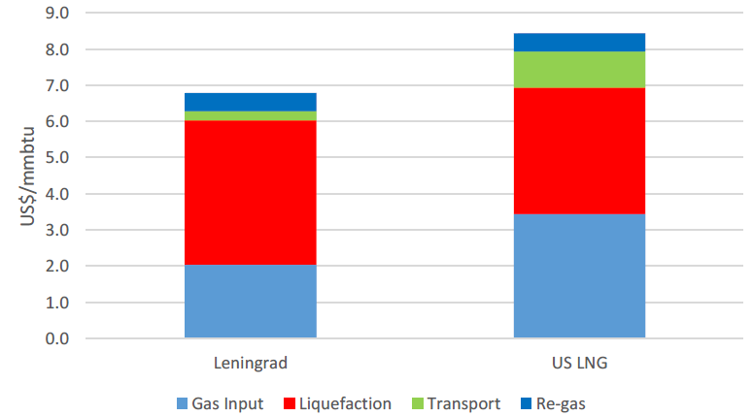
EUROPEAN GAS MARKET
Major opponents – USA LNG and strategies against it
RUSSIA
US LNG

Slide 46
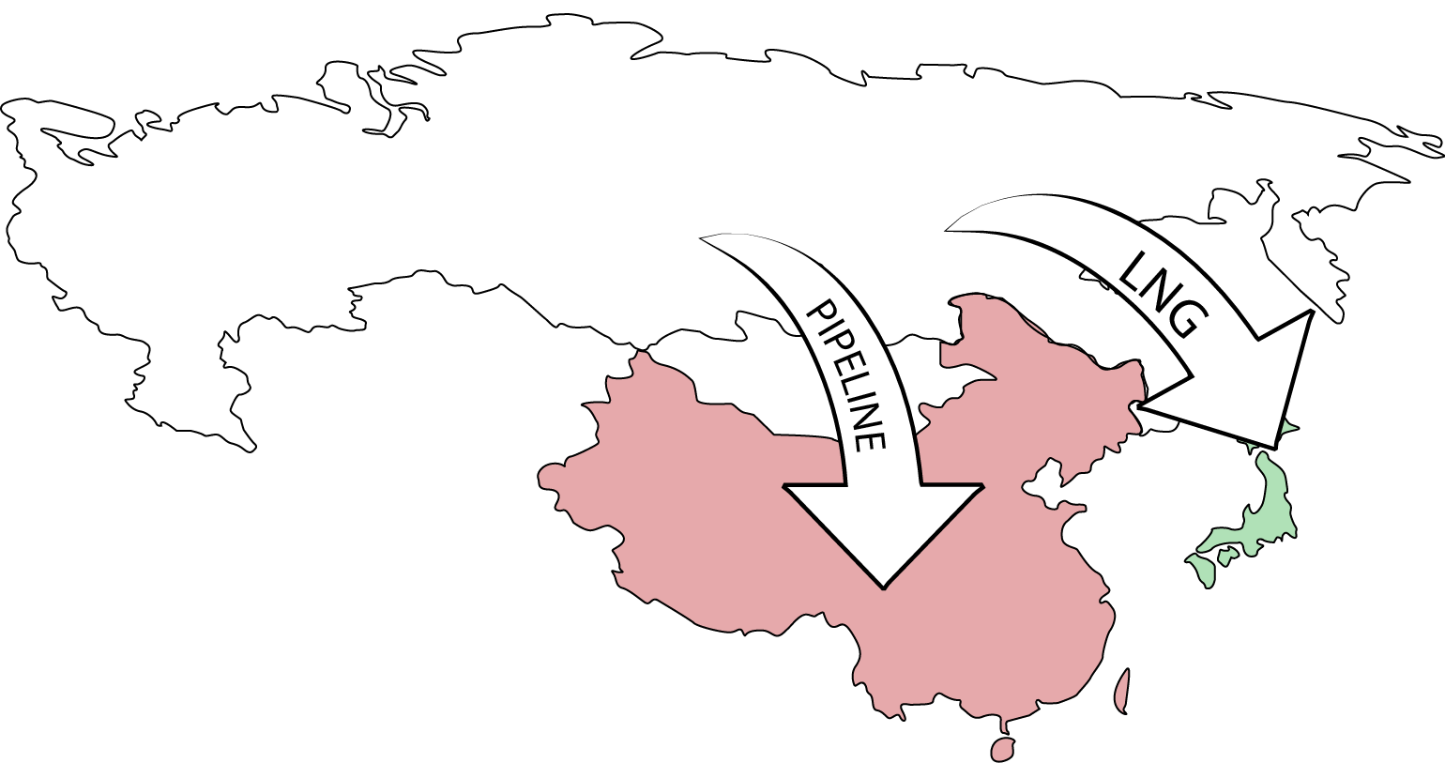
EASTERN GAS MARKETS

Slide 47
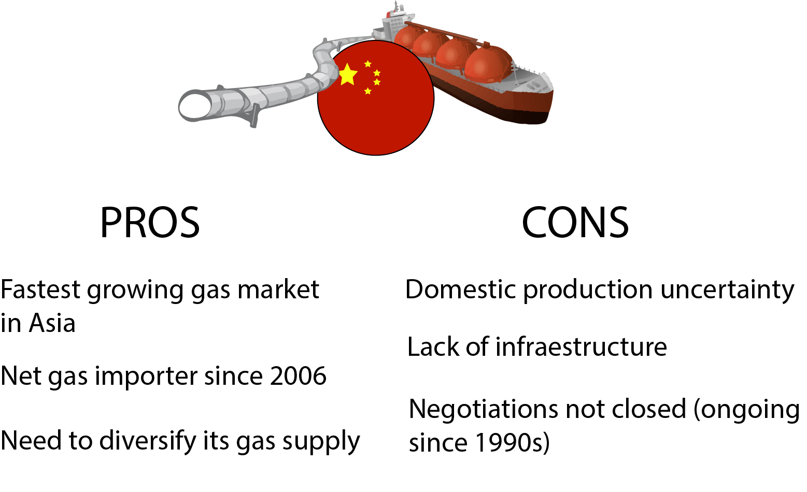
CHINA’s GAS MARKET

Slide 48
CHINA’s GAS MARKET
1) Does China need the Russian gas?
2) Is Russian gas competitive with China’s supply alternatives?

Slide 49
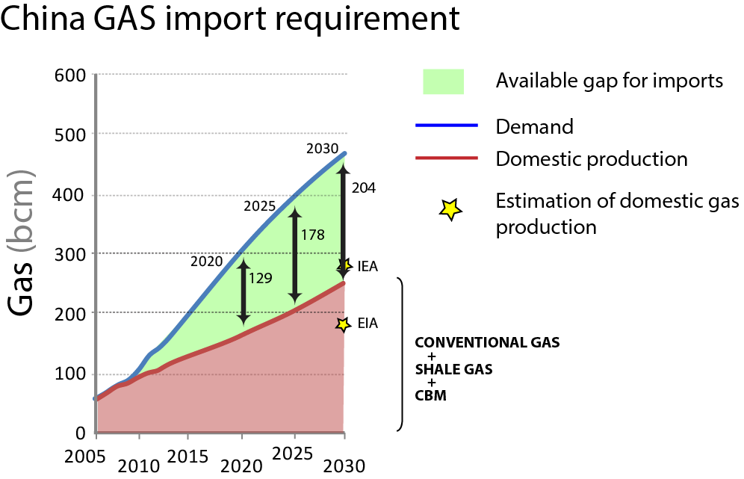
GAS DEMAND & PRODUCTION CHINA
Data from IEA, EIA, CNPC

Slide 50


GAS IMPORTS OUTLOOK

Slide 51

RUSSIAN GAS COMPETITIVENESS
Prices from (Henderson, 2015)

Slide 52

RUSSIAN GAS COMPETITIVENESS

Slide 53

RUSSIAN GAS COMPETITIVENESS

Slide 54

GAS IMPORTS OUTLOOK

Slide 55

GAS DEMAND RUSSIA

Slide 56

GAS DEMAND JAPAN
NUCLEAR RESTART IN JAPAN
Data from (Rogers, 2016)

Slide 57

GAS DEMAND JAPAN
Data from (Rogers, 2016)

Slide 58



GAS DEMAND RUSSIA
Data from (Rogers, 2016)

Slide 59

GAS MARKET SUMMARY

Slide 60
CONCLUSIONS
Oil export to Europe is important for Russia and will continue but the export doesn´t have chances to increase
Concession contracts with European companies can help Russia be a winner in the energy game
US LNG will not be able to compete with Russian gas
EU will always be an important market for Russia
East markets will open up to Russia and will account for % of Russia`s gas exports by 2030

Slide 61
СПАСИБО
(Thank you!)

